Slide 1

ESE_4009 Embedded Systems Design Project
Task: Interfacing RFID and Buzzer
Submitted To: Prof. Mike Aleshams
Submitted by: Shubham Setia (c0752336)
GROUP - 7

Slide 2
Overview
This task is based on interfacing RFID and Buzzer
This project is called IOT Enabled Beaglebone based smart parking system with SMS alert.

Slide 3
List Of Hardware Components
Beaglebone Black
Ultrasonic sensors
RFID
WiFi module
Gsm Module
Servo motor
Buzzer
Voltage Regulator
Adapter
Soldering Iron Kit with Multimeter
Jumper wires and Bread Board

Slide 4
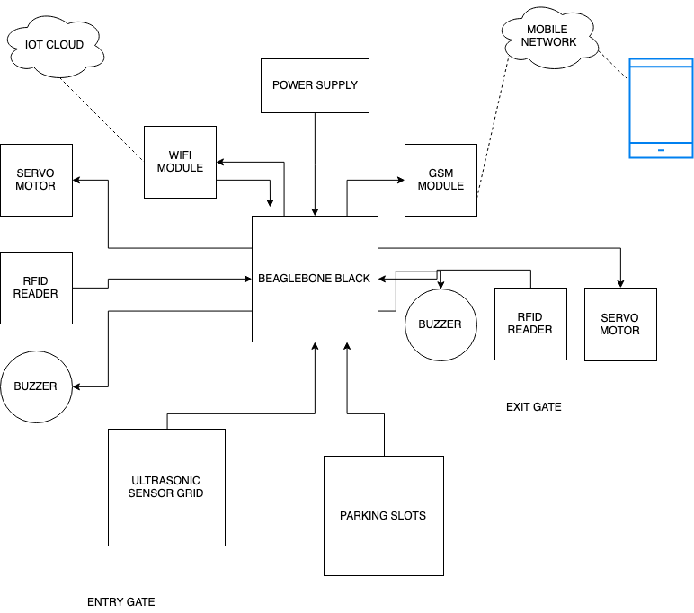
Project Block Diagram

Slide 5
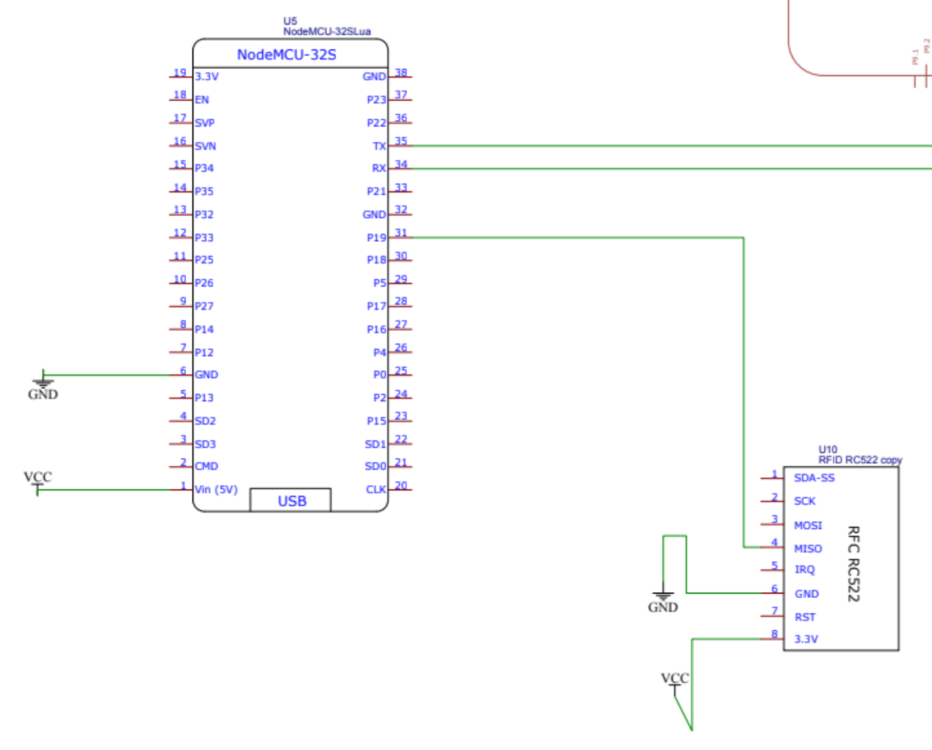
Schematics

Slide 6
Software Tools
Windows OS
PuTTY
GCC Compiler
Win SCP
Arduino IDE

Slide 7
Iobb Library
Iobb allows for easy general-purpose input/output (GPIO), SPI and I2C using the Beaglebone Black (BBB) and other BBB variants such as the BeagleBone Black Industrial and Beaglebone Black Wireless.
This library is also PocketBeagle friendly.
This library is designed to be easy-to-use, it is quite simple, and it allows for reasonably speedy I/O. There is plenty of demo source code too.

Slide 8
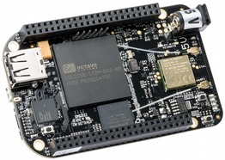
BeagleBone Black Rev C
It will be used as the main microcontroller. Box also includes a miniUSB to USB Type A cable. It is low cost, compact board used to build complex applications.
It is designed to fulfill requirements in fields such as gaming devices, home and industrial automation, consumer medical and intelligent machines and many more.

Slide 9
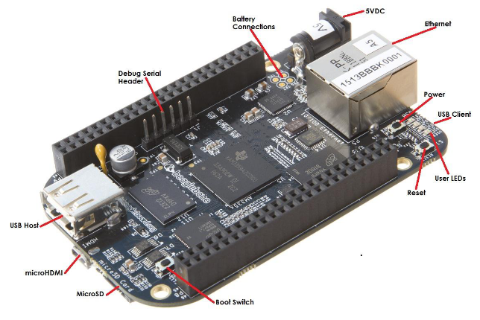
Specifications
Processor:
AM335x 1GHz ARM® Cortex-A8
512MB DDR3 RAM
4GB 8-bit eMMC on-board flash storage
3D graphics accelerator
NEON floating-point accelerator
2x PRU 32-bit microcontrollers

Slide 10
Software Compatibility
Debian
Android
Ubuntu
Cloud9 IDE on Node.js w/ BoneScript library

Slide 11

Connectivity
USB client for power & communications
USB host
Ethernet
HDMI
2x 46 pin headers

Slide 12
Arduino IDE
The Arduino Integrated Development Environment (IDE) is a cross-platform application (for Windows, macOS, Linux) that is written in functions from C and C++. It is used to write and upload programs to Arduino compatible boards, but also, with the help of third-party cores, other vendor development boards.
The source code for the IDE is released under the GNU General Public License, version 2. The Arduino IDE supports the languages C and C++ using special rules of code structuring.
The Arduino IDE supplies a software library from the Wiring project, which provides many common input and output procedures. User-written code only requires two basic functions, for starting the sketch and the main program loop, that are compiled and linked with a program stub main() into an executable cyclic executive program with the GNU toolchain, also included with the IDE distribution.

Slide 13

Interfacing RFID- RC522

Slide 14
RFID Reader
Radio frequency Identification (RFID) is a wireless identification technology that uses radio waves to identify the presence of RFID tags.
Just like Bar code reader, RFID technology is used for identification of people, object etc. presence.
In RFID technology we just need to bring RFID tags in range of readers. Also, barcodes can get damaged or unreadable, which is not in the case for most of the RFID.
RFID is used in many applications like attendance system in which every person will have their separate RFID tag which will help identify person and their attendance.
RFID is used in many companies to provide access to their authorized employees.
It is also helpful to keep track of goods and in automated toll collection system on highway by embedding Tag (having unique ID) on them.

Slide 15

RFID TAG
RFID tag includes microchip with radio antenna mounted on substrate which carries 12 Byte unique Identification number.

Slide 16
RFID Reader
It is used to read unique ID from RFID tags. Whenever RFID tags comes in range, RFID reader reads its unique ID and transmits it serially to the microcontroller or PC. RFID reader has transceiver and an antenna mounted on it. It is mostly fixed in stationary position.
There are 3 types of RFID Readers:- Active, Passive and active-passive Readers.

Slide 17
PuTTY
PuTTY is a free and open-source terminal emulator, serial console and network file transfer application.
It supports several network protocols, including SCP, SSH, Telnet, rlogin, and raw socket connection.
It can also connect to a serial port.
The name "PuTTY" has no official meaning.

Slide 18
Connections with ESP-32 for interfacing
WiFi & Bluetooth- ESP-32 | RFID- RC522
G23 | MOSI
P22 | RST
P21 | SDA
P19 | MISO
P18 | SCK
GND | GND
3.3V | 3.3V
The interfacing of RFID with ESP-32 is done through SPI communication protocol.
The pins of RFID are directly connected to pins of the ESP-32 module with female to female jumper wires.
To interface the RFID- RC522 various pins are used as shown in the table as our connections.

Slide 19
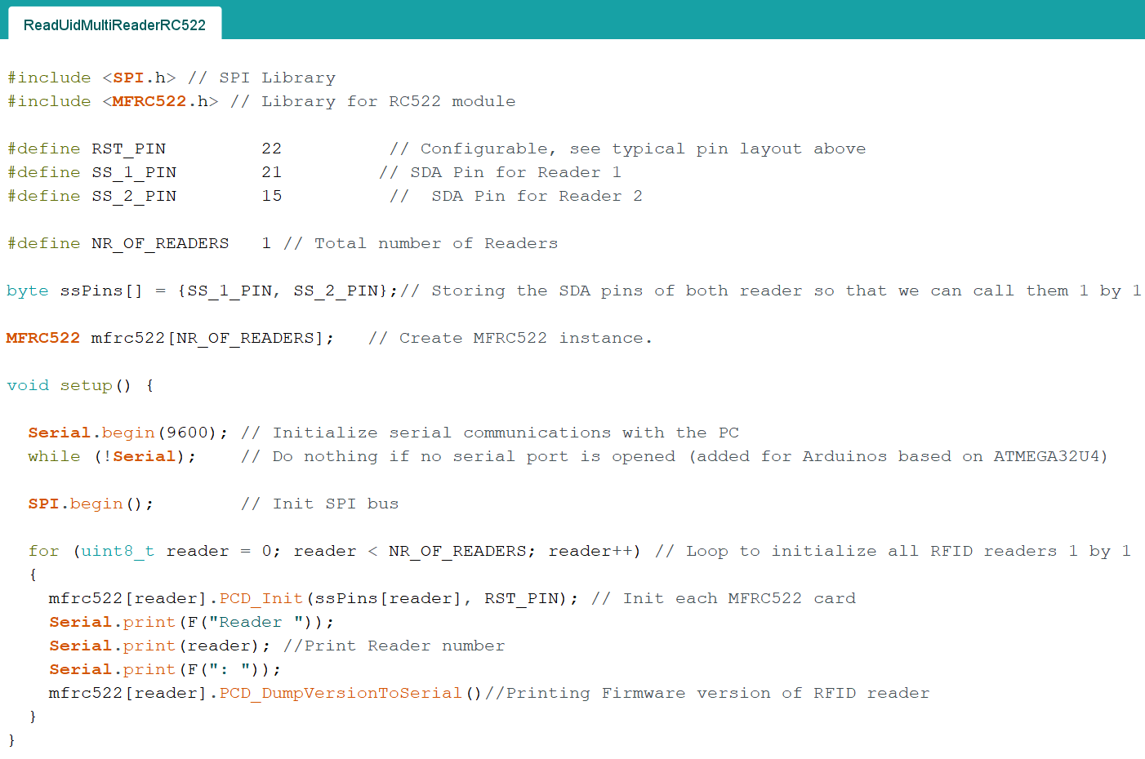
CODE

Slide 20
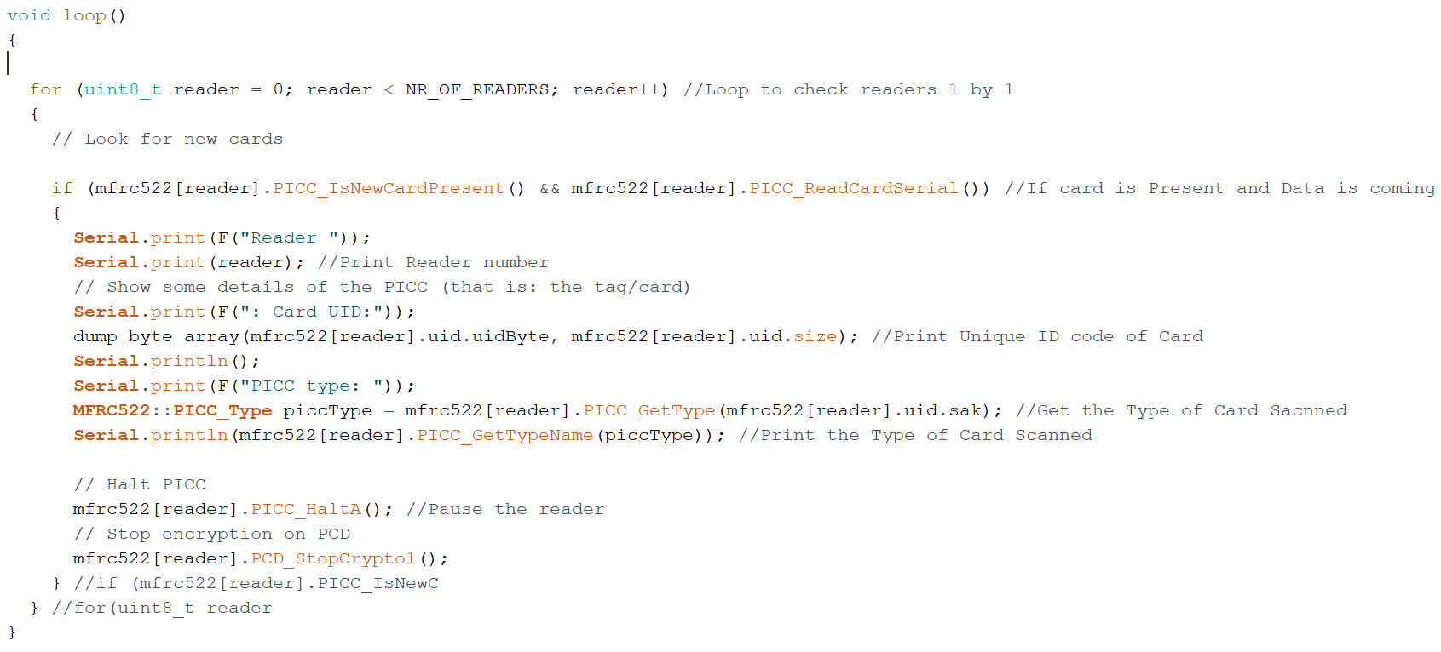
CODE (Cont.)

Slide 21
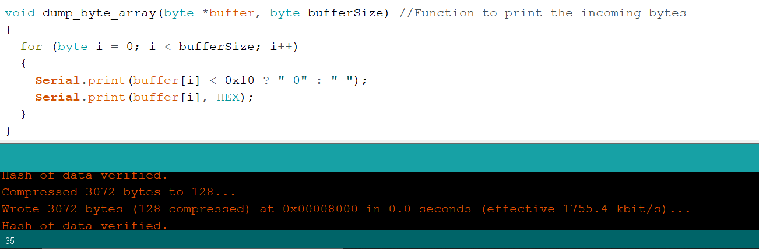
CODE (Cont.)

Slide 22
Interfacing Buzzer

Slide 23
Buzzer
A buzzer or beeper is an audio signalling device, which may be mechanical, electromechanical, or piezoelectric (piezo for short).
Typical uses of buzzers and beepers include alarm devices, timers, and confirmation of user input such as a mouse click or keystroke.

Slide 24
Specifications
Color: Black
Driver Circuitry: Transducer
Input Type: Zero-Peak Signal
Frequency: 2Khz
Technology: Piezo
Operating Mode: Ringer
Sound Pressure Level: 70 db@1.5v
Operating Temperature:-20c-70c
Mounting type: Through hole

Slide 25
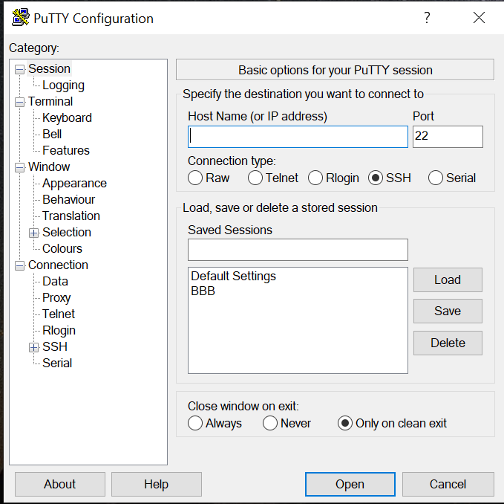
Connect to Beaglebone
PuTTY requires Host name or IP address of the machine we want to connect, the port number and the connection type.
For the connection, the host name will be 192.168.7.2
The port number is default 22
The connection type will be SSH

Slide 26
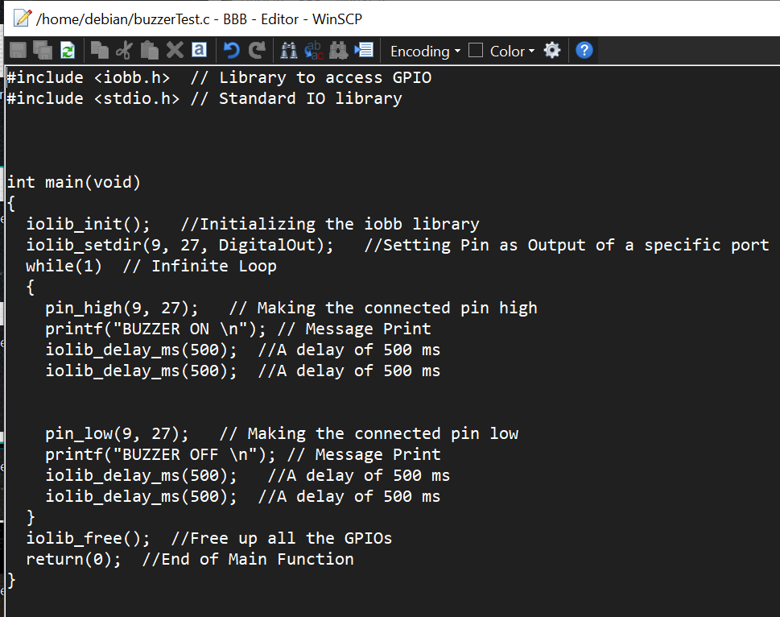
CODE

Slide 27
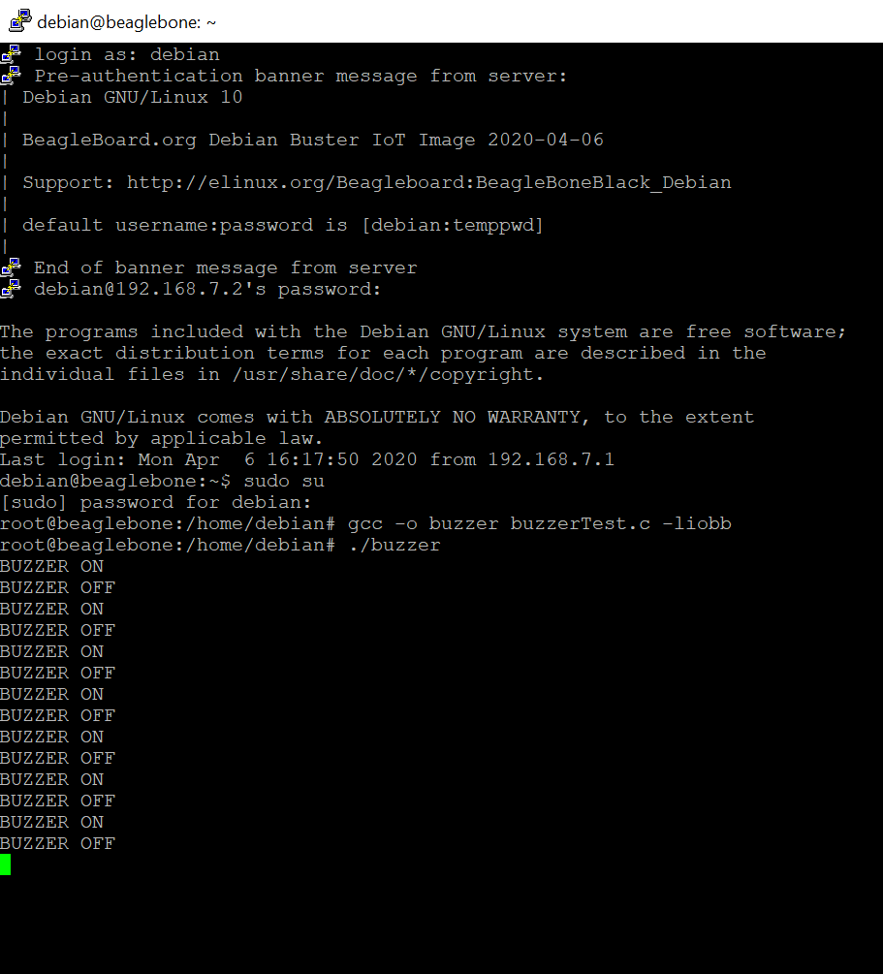
Program Execution
The program is made in the C language
The program is executed in the Debian
GCC compiler is used to compile the program
The commands used in the PuTTY are like those used in the Linux terminal as both are executed in the Debian.

Slide 28

Result

Slide 29
WinSCP
WinSCP is an open source free SFTP client, FTP client, WebDAV client, S3 client and SCP client for Windows. Its main function is file transfer between a local and a remote computer.
Beyond this, WinSCP offers scripting and basic file manager functionality.

Slide 30
Features of WinSCP
Shares site settings with PuTTY
Graphical user interface (screenshots)
Translated into many languages
Integration with Windows (drag drop, URL, shortcut icons, jump list)
All common operations with files
Support for SFTP and SCP protocols over SSH and FTP and WebDAV and S3 protocols.

Slide 31
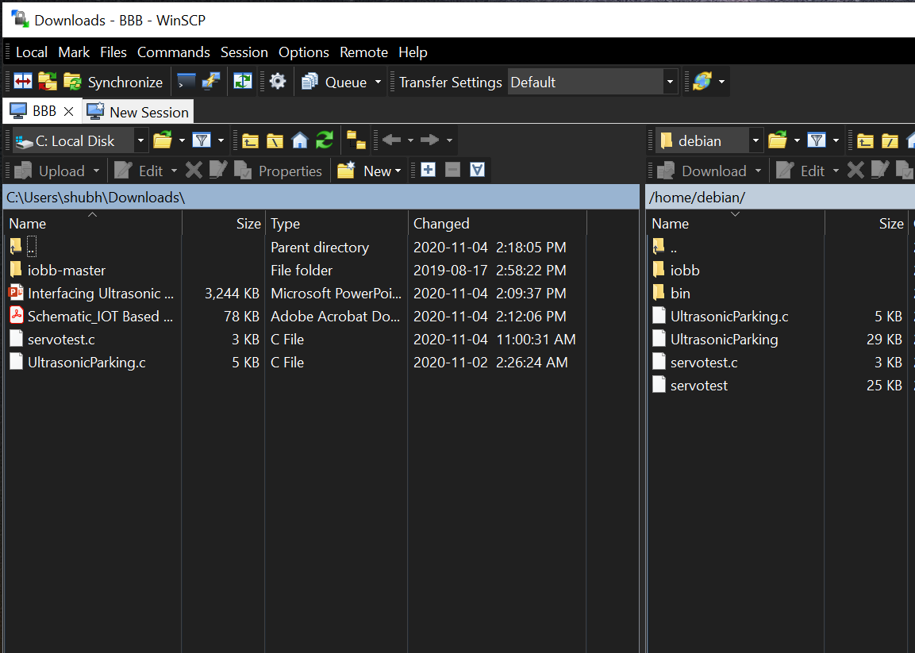
File Transfer
When you start WinSCP, the program will ask you for your login information. In most cases, you will only need to select the server’s protocol, enter the host name, username, and password, and then click Login.
The program will open a directory window like Windows File Explorer.

Slide 32
Pin Configuration
Buzzer | BeagleBone Black
Positive terminal (Red) | DGND (P9_1)
Negative terminal (Black) | GPIO_115 (P9_27)
The interfacing of the buzzer with Beaglebone black is done through digital logic.
The pins of the buzzer are directly connected to the GPIO pins of the Beaglebone black.
To interface the buzzer; pins 2 and 8 of P9; pin 12 of P8 of the Beaglebone are used.
Pin 8 of P9 is used as the power supply to the motor.

Slide 33
Working
The input and output pins of the buzzer are connected to the Beaglebone.
The pins are also initialized in the C program.
Loops are used so that the buzzer works continuously.
The code is executed and run in the Beaglebone itself.

Slide 34
Issues while interfacing RFID and Buzzer
As the jumper cables are not soldered yet, the output is sometimes irregular due to improper connection.
A lot of commands were to be used to move the iobb library and the code to the Beaglebone black. But, this drawback was later outcome by WinSCP.
If the computer restarts or shuts down, the PuTTY needs to be connected again and the commands are not saved as in Linux terminal.
We needed to flash the Beaglebone before interfacing.

Slide 35
Supporting Hardware
Adapter- An adapter or adaptor is a device that converts attributes of one electrical device or system to those of an otherwise incompatible device or system
Jumper wires (Male to male and Female to Female)

Slide 36
References
1. beaglebone black. (2019, September 06). Retrieved from beagleboard: https://beagleboard.org/black
2. Shabaz. (2019, August 15). iobb library. Retrieved from element14: https://www.element14.com/community/community/designcenter/single-board-computers/next-genbeaglebone/blog/2019/08/15/beaglebone-black-bbb-io-gpio-spi-and-i2c-library-for-c-2019-edition
3. https://winscp.net/eng/docs/start
4. https://github.com/shabaz123/iobb
5. https://www.putty.org/
6. http://www.ee.ic.ac.uk/pcheung/teaching/DE1_EE/stores/sg90_datasheet.pdf
7. https://www.youtube.com/watch?v=ceTYMgdfhRk

